Slide 1
Pedestrian Analysis
Ashish Kumar (2016CSB1033)
Chirag Khurana (2016CSB1037)
CSL-462

Slide 2



Introduction
Predict in which direction the pedestrian is walking.
Detect the pedestrian is distracted or not.
Motivation:
Pedestrian safety
Self driving cars
0°
90°
Distracted

Slide 3
Literature Review
HOG and SVM.
Haar features and 16 SVMs.
Gradient Bins with SVM and Hidden markov models.

Slide 4
Methodology

Slide 5
Non Deep Learning Approach
Baseline Approach
HOG feature vector (3780)
Support Vector Machine
Accuracy: 78%
Enhanced Approach
Gaussian Pyramid
HOG feature vector
Support Vector Machine
Accuracy: 82%
HOG feature
SVM
Direction
128 x 64
HOG feature
SVM
Direction

Slide 6
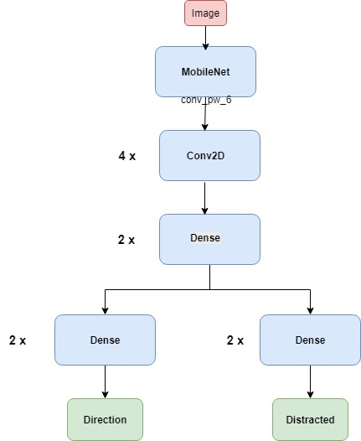
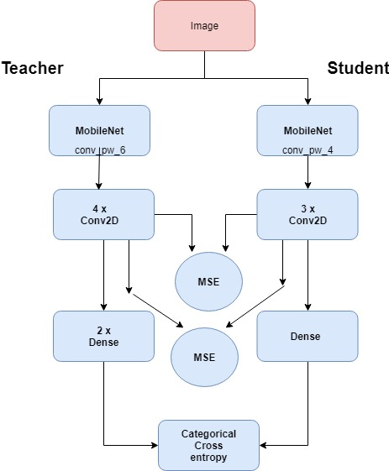
Deep Learning Approach
Low Computational Model
Pre-trained MobileNet
Knowledge Distillation
Student Accuracy: 94.3%
Teacher Accuracy: 95.81%
High Computational Model
Pre-trained MobileNet
Additional layers
Two outputs: direction and distraction.
Direction Accuracy: 94.3%
Distraction Accuracy: 77.64%
High Computational
Low Computational

Slide 7
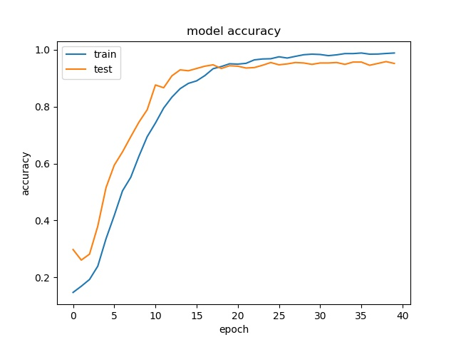
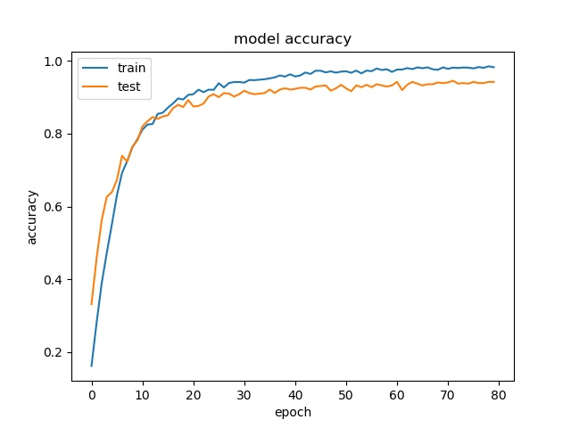
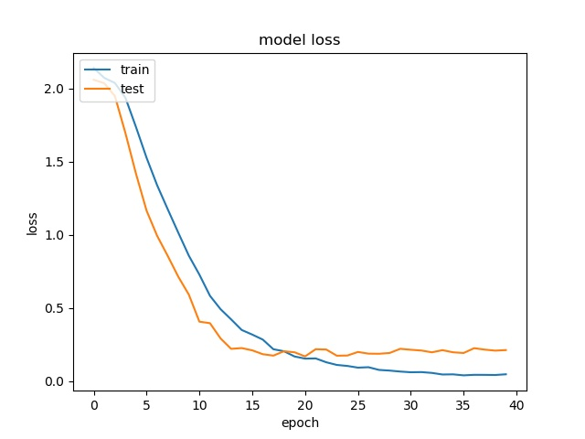
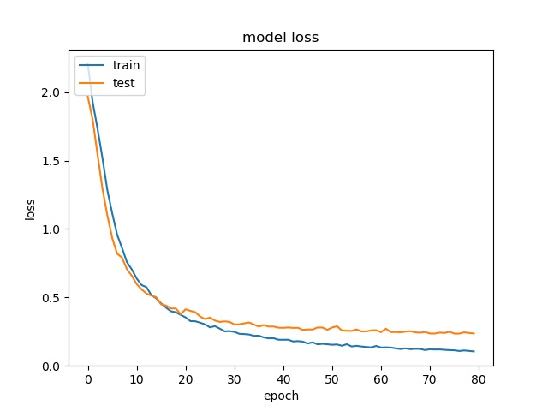
Teacher Model Student Model
Model requires only 23 MB space after knowledge distillation compared to 72 MB of the teacher model. The inference time of small model on a mobile phone is just 130 ms on an average.

Slide 8
Summary and Future Work
Proposed a method based on neural network to predict the moving direction of pedestrian and estimate whether the pedestrian is distracted or not.
Both the pedestrian moving direction and distraction results can be used for further decision making by automatic or semi-automatic vehicles to prevent mishappenings on the roads.
Only used the information present in one image. Temporal information can also be very useful in providing the information for the prediction model, especially in case of distraction prediction it can result in magnitudes of increase in prediction accuracy.

